Slide 1
Roll call systems
Pham Huy Hoang
Nguyen Quoc Huy
Nguyen Thanh Binh

Slide 2
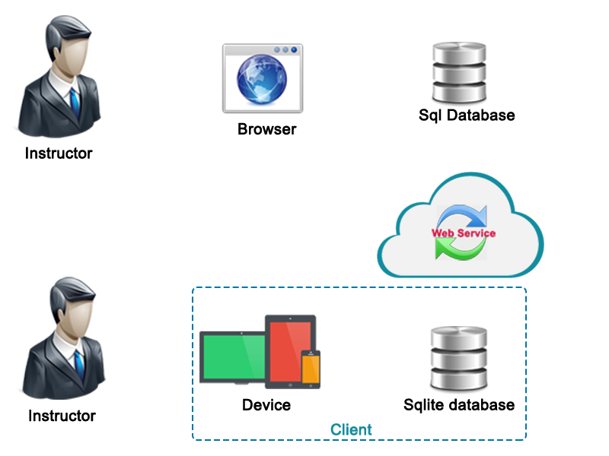



Process
3
5
Flow sql server
Flow sqlite
Using website
4
2
4
5
2
1
3
1
6

Slide 3
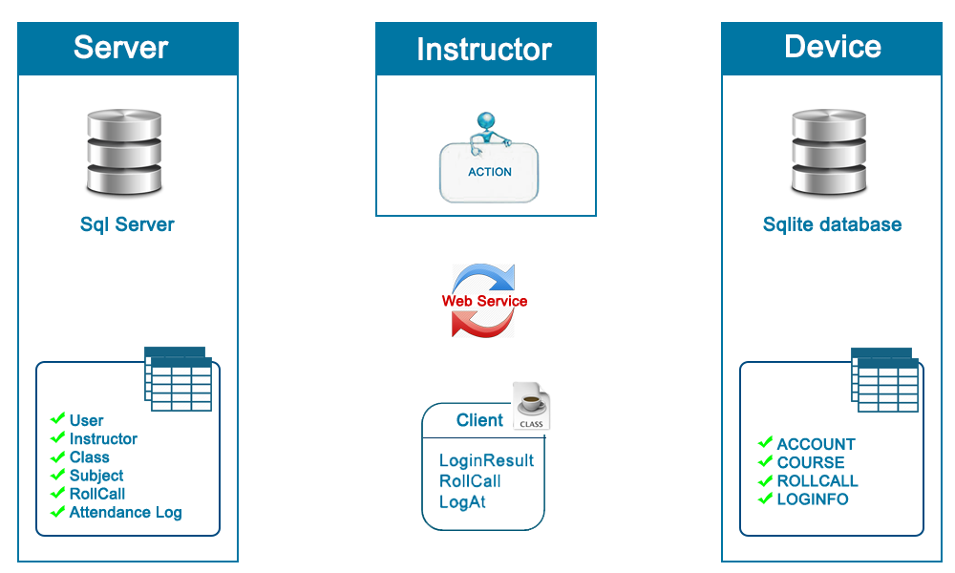
Managements data sync
Online mode
Offline mode
Sync database

